Slide 1
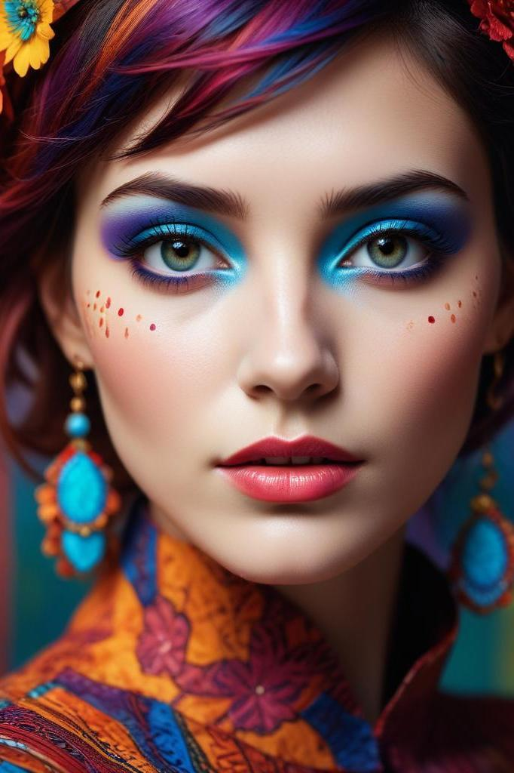
JoJoGAN: One-Shot Face Stylization
A deep learning approach enabling artistic style transfer with minimal data.

Slide 2
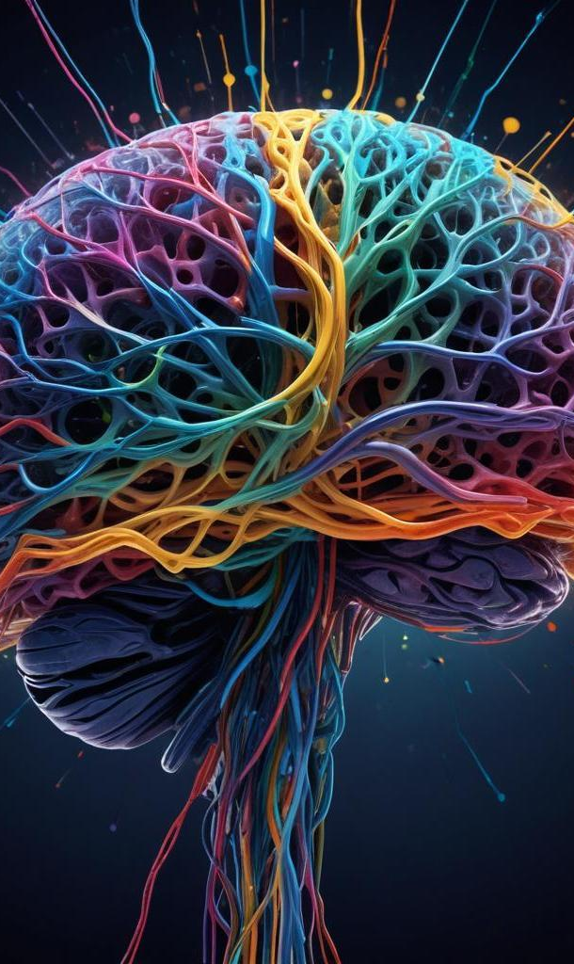
Introduction

Slide 3
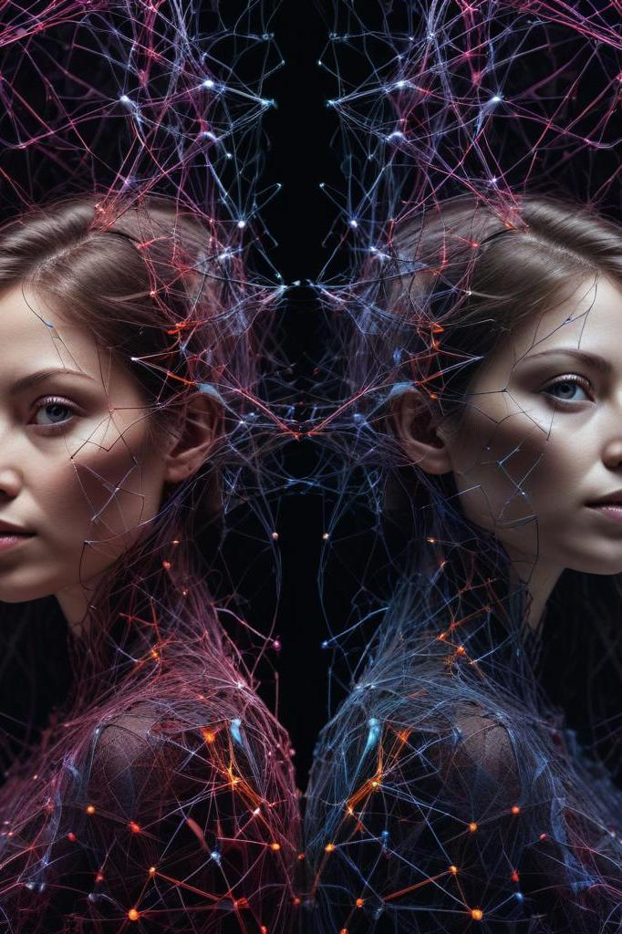
01
JoJoGAN Overview

Slide 4
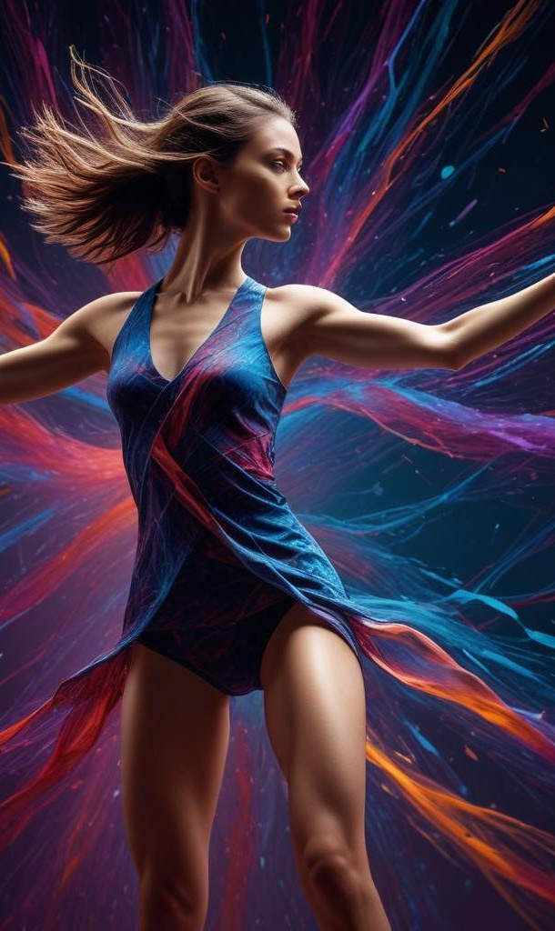
Deep learning framework for face stylization
JoJoGAN is a cutting-edge framework that leverages deep learning techniques, particularly Generative Adversarial Networks (GANs), to perform one-shot face stylization. It allows for artistic transfer onto human faces using a single reference image, differentiating it from traditional methods that typically require extensive datasets. This innovation not only streamlines the artistic process but significantly enhances efficiency and accessibility.

Slide 5
Advantages over traditional methods
Traditional face stylization approaches often necessitate large datasets to achieve high-quality results and frequently struggle with maintaining facial identity during the artistic transfer. JoJoGAN addresses these issues by enabling stylization with just one reference image, effectively preserving facial features while artistically enhancing them. This results in a balanced output that marries realism with artistic interpretation.

Slide 6
Applications in various fields
The applications of JoJoGAN span a variety of industries, including digital art creation, video game design, and entertainment. By facilitating high-quality stylization with minimal input, it opens new avenues for artists, game developers, and content creators to produce unique visual content quickly. Additionally, its efficiency could enable real-time applications in areas such as augmented reality.

Slide 7

02
Core Concepts

Slide 8
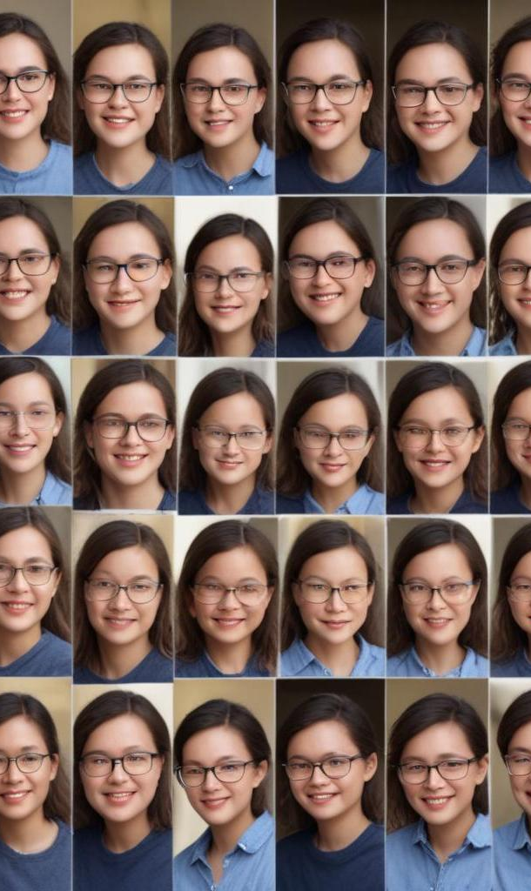
Generative Adversarial Networks (GANs)
GANs are a class of machine learning frameworks that consist of two neural networks: the generator, which creates images, and the discriminator, which evaluates them. These networks engage in a competitive process, where the generator aims to produce outputs indistinguishable from real images, while the discriminator seeks to correctly identify real versus generated content. This adversarial training leads to the production of highly realistic images.

Slide 9
GAN Inversion process
GAN Inversion is a technique that allows real images to be mapped into the latent space of a pretrained GAN model. This process is crucial for enabling the generation of paired data, which is beneficial for tasks like face stylization. By effectively translating an image into a form that the GAN can manipulate, it sets the stage for precise and effective artistic transfers.

Slide 10
StyleGAN architecture and features
StyleGAN, a specific implementation of GANs, is designed for generating high-resolution images with customizable style attributes. It employs adaptive instance normalization layers that allow for the manipulation of various visual features, providing artists with a flexible tool for stylization. This architecture supports adjustments in style strength and content independently, facilitating more refined and controlled artistic outcomes.

Slide 11

03
Implementation Process

Slide 12
Data preparation techniques
Data preparation for JoJoGAN involves careful selection and preprocessing of reference images. This process includes resizing images to a standard resolution, normalizing pixel values to a consistent range, and augmenting datasets with variations to enhance model robustness. These techniques ensure that the input images retain essential features, facilitating effective stylization by the network.

Slide 13
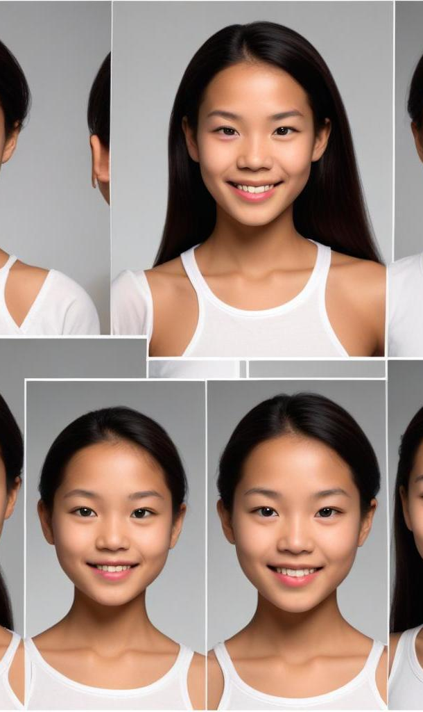
Model training methodology
The model training for JoJoGAN utilizes a pre-trained StyleGAN model that is fine-tuned on the prepared dataset. This involves applying a discriminator perceptual loss to ensure that stylistic elements are emphasized while maintaining identity. The training process iterates over multiple epochs, utilizing a combination of qualitative assessments and quantitative evaluations to optimize the model's performance.

Slide 14
Evaluation metrics used
Evaluation of JoJoGAN's stylized outputs is conducted using both qualitative and quantitative metrics. Qualitative assessments involve visual inspections by experts to gauge aesthetic appeal and fidelity to the reference style. Quantitative metrics include the Fréchet Inception Distance (FID), which quantifies the quality of generated images by comparing the distribution of generated images to that of real images, providing an objective measure of performance.

Slide 15
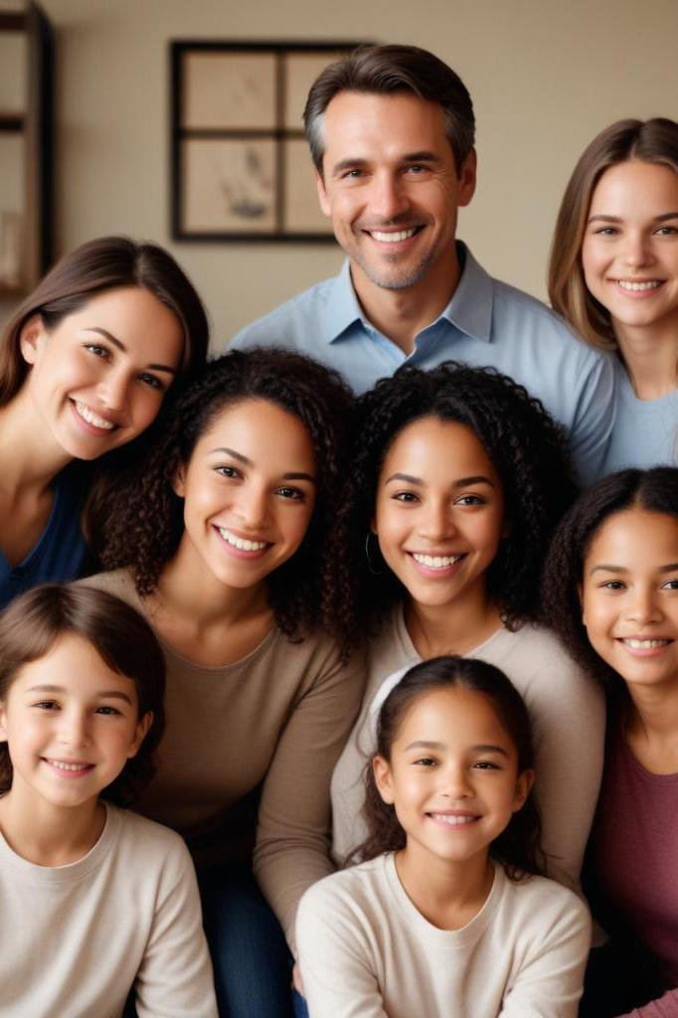
04
Results Achieved

Slide 16
Quality of stylization outcomes
JoJoGAN has demonstrated the ability to produce high-quality stylization outcomes that are visually impressive and convincing. The framework has achieved remarkable results in terms of color balance, texture richness, and overall image coherence, making it suitable for artistic applications and professional usage in creative fields.

Slide 17
Preservation of facial features
One of the significant advantages of JoJoGAN is its capacity to preserve critical facial features during the stylization process. Unlike many traditional methods, JoJoGAN maintains the identity of the individual while applying artistic transformations, ensuring that key characteristics such as eyes, mouth, and facial structure remain recognizable.

Slide 18
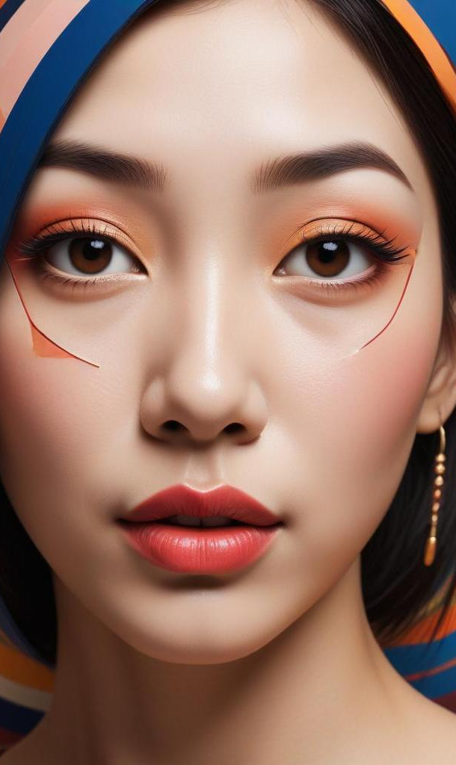
Artistic detail representation
JoJoGAN excels in capturing intricate stylistic details, such as bold lines, unique shapes, and complex textures. The model effectively translates the artistic style of the reference image onto the target face, resulting in outputs that not only resemble the original subject but also present an enhanced aesthetic quality that is rich in artistic expression.

Slide 19
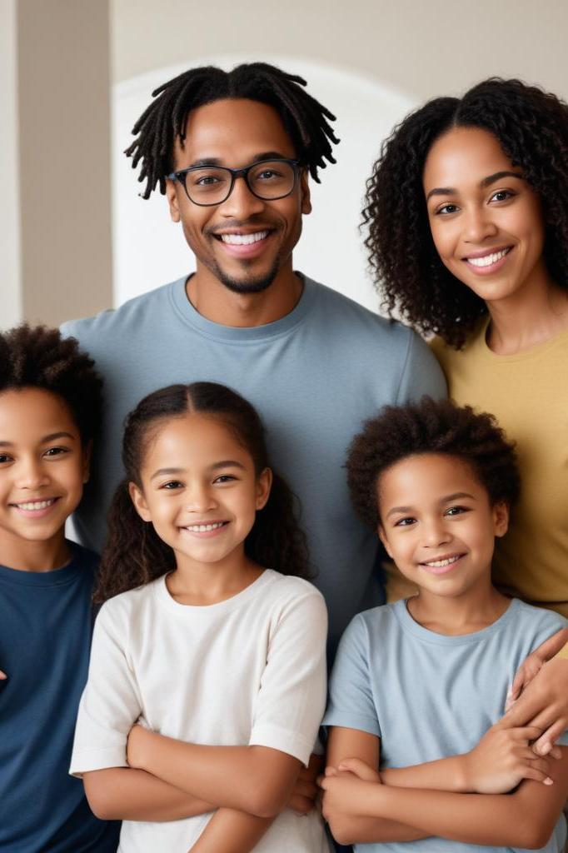
05
Standards and Future Work

Slide 20
Adopted design and coding standards
In developing JoJoGAN, various design and coding standards have been adopted to ensure high-quality software practices. This includes following IEEE guidelines for documentation, utilizing UML diagrams for architectural representation, and maintaining a modular approach to code organization. These standards facilitate code readability, maintainability, and collaborative development.

Slide 21

Testing standards followed
The testing phase of JoJoGAN followed established ISO guidelines for software verification and validation. Comprehensive testing was carried out to assess the model's performance, functionality, and reliability. This structured testing framework ensures that the software meets industry standards and performs as expected under various conditions.

Slide 22
Future enhancements and explorations
Future work for JoJoGAN includes exploring real-time video-based stylization capabilities, enhancing scalability for processing larger datasets, and developing support for multiple artistic styles within a single processing pipeline. These advancements aim to expand its applicability in dynamic contexts and further leverage its artistic potential.

Slide 23
Conclusions
JoJoGAN represents a significant advancement in face stylization techniques, effectively addressing challenges associated with few-shot learning. By facilitating artistic style transfer from a single reference image while preserving critical facial features, JoJoGAN positions itself as an innovative solution for artists and creators. The expected future developments will likely enhance its functionality, making it a versatile tool in the realms of digital art and entertainment.

Slide 24

Thank you!
Do you have any questions?
+91 620 421 838

